Slide 1
Product Development
When the New Product Development idea is in place, the market strategy is documented, and the business analysis is completed, it is time to move on with the product life-cycle development process.
The New Product Development starts with developing the prototype followed by MVP.

Slide 2
1. Prototype
This focuses on creating the UI/UX for the product, which is then shared with the stakeholders. This helps in visualizing how the product will look and whether it complies with ergonomics best practices.

Slide 3
2. Minimum Viable Product (MVP)
This focuses on working on the user stories in Agile for the New Product that will set it apart from others. Once the design, development, and testing are done, the MVP is launched in the market with minimal features. The future iterations depend on the initial response.
The best way to approach New Product Development is to rely on Agile Product Development that focuses on incremental and iterative development while promoting collaboration and communication.
This is better than the waterfall approach as it allows for to-and-fro movement across the product development cycle as new user requirements emerge. Though the development stages of Waterfall and Agile are similar, these software development methodologies differ.

Slide 4
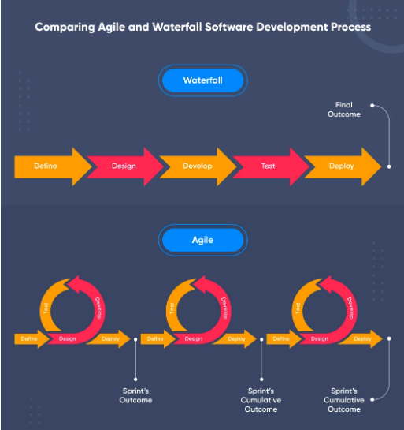

Slide 5
Deployment
Once the MVP is ready, efforts shift from development to deploying the product in the live environment. This process involves embracing the DevOps culture and implementing the CI/CD pipeline.
The different stages of implementation include:
a. Commit
b. Build
c. Alpha Deployment
d. Beta Deployment
e. Production Deployment

Slide 6
a. Commit
This stage involves:
The newly developed features are integrated with the code for the existing features
Quality assurance team ensures that the integrated code works fine
CI/CD tools such as Jenkins run automated unit tests and sanity tests to check code’s efficacy
b. Build
This stage involves:
Developers push the software artifacts into the registry using Docker tools such as Gradle, Packer, AZK, etc.
c. Alpha Deployment
This stage involves:
Developers test the performance of the new builds and the interactions between those builds.
d. Beta Deployment
This stage involves:
Manual testing of the new product to validate its overall performance and efficiency of output considering all input scenarios.
e. Production Deployment
This stage involves:
The product is pushed into the live environment, i.e., the product is available and ready to use by the end-users.

